Slide 1
Mutanci są wśród nas – testy mutacyjne
Michał Dubel

Slide 2
Transition Technologies
Polski producent oprogramowania od 1991 roku
9 biur w Polsce,
1 w USA,
Biura sprzedażowe w Niemczech i UK
Wykwalifikowana kadra
750+ osób
Rozwiązania IT dla energetyki, rynku gazu, przemysłu i medycyny
Ponad 450 referencji od polskich i zagranicznych klientów
Status Centrum Badawczo- Rozwojowego, jedna z 35 polskich firm
Zintegrowany System Zarządzania Jakością
ISO 9001, 20000, 27001, OHSAS
Ścisła współpraca z uczelniami wyższymi na całym świecie

Slide 3
Stale powiększająca się liczba oddziałów
9 oddziałów w Polsce (Olsztyn- wkrótce otwarcie)
Biura sprzedażowe w Niemczech i Wielkiej Brytanii
Transition Technologies USA Inc. w Pittsburghu
Koszalin
Olsztyn
Białystok
Warszawa
Ostrów Wlkp.
Łódź
Wrocław
Lublin
Kielce

Slide 4
Poland Solution Center
Łódź, Białystok, Kielce
Umowa partnerska z Parametric Technology Corporation (PTC)
10 lat razem
Wsparcie dla gałęzi:
PLM (Product Lifecycle Management)
SLM (Service Lifecycle Management)
IoT (Internet of Things)
Bliska współpraca w ramach PTC R&D

Slide 5

Instead of agenda… rise Your hand !
Unit testing
Integration testing
TDD
Continuous Integration
Code coverage measures
Mutation testing

Slide 6
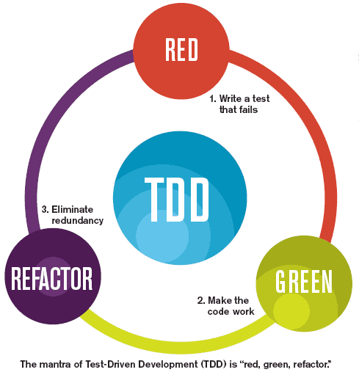
Why testing ? Test Driven what ?
Testing is cool
Testing makes Your life easier
Testing makes You work faster
Testing makes Your code better
Write test then code aka TDD
Writing good tests is hard and takes practice

Slide 7
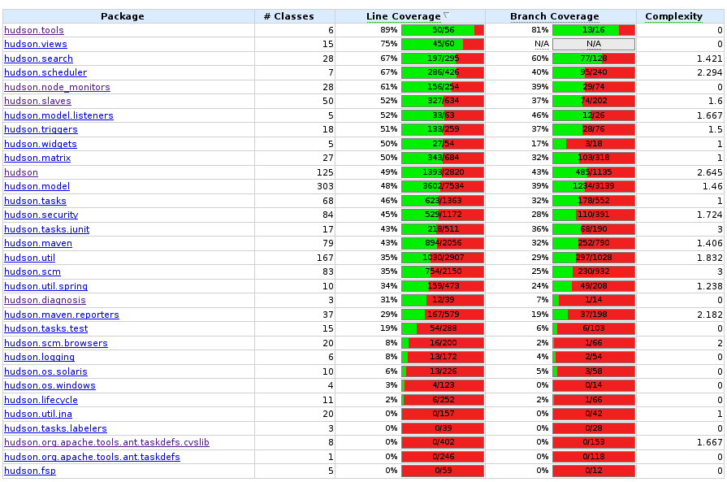
Code coverage
„In computer science, code coverage is a measure used to describe the degree to which the source code of a program is tested”
Wikipedia - https://en.wikipedia.org/wiki/Code_coverage

Slide 8

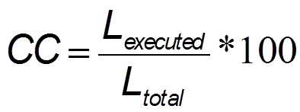
Code coverage - tools
Clover
EclEmma
Cobertura
And more…

Slide 9
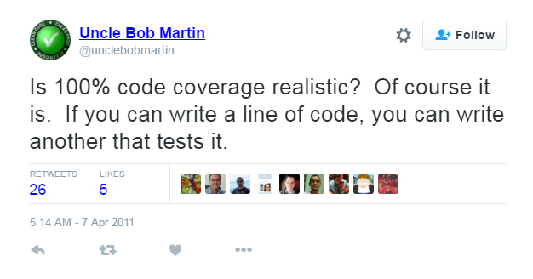
100% Code Coverage = Holy Grail ?
Robert C. Martin (Uncle Bob) https://twitter.com/unclebobmartin/status/55966620509667328

Slide 10
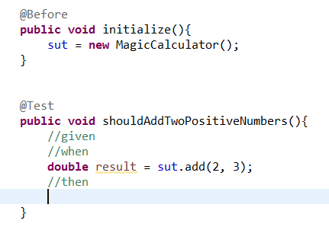
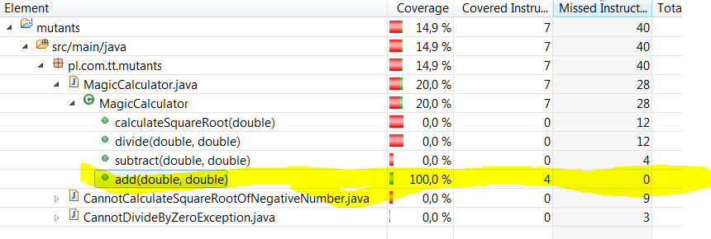
100% Code Coverage = Holy Grail ?

Slide 11

Code Coverage = code quality metric ?
Any metric can be fooled
CC is a metric
CC would be fooled:
Accidentaly
On purpose
Did You see (or write ?) tests:
without verifications or assertions?
• just to fake and boost coverage?
100% branch coverage proves (almost) nothing

Slide 12





Mutation testing
Proposed by Richard J. Lipton in 1971 (winner of 2014 Knuth Prize)
A way to measure the quality of your tests
Original code Mutation Mutated codebase

Slide 13
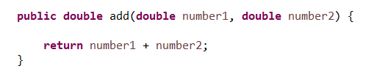
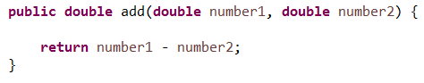
Mutation
Small (yet significant) change in Your code, ex:

Slide 14

Mutation workflow – standard testing
Execute tests

Slide 15

Mutation workflow – mutation testing
Execute same tests

Slide 16

Mutation workflow – testing outcome
Execute same tests
Mutant survived
Mutant killed
Execute same tests

Slide 17

Killing mutants (in code)
Killing mutants is GOOD !

Slide 18

So gooood… why not used widely since ages ?
Lack of tools
Production code modifications
Time, time, time !
Endless loops
Overflow

Slide 19

Tools for Java
• µJava: http://cs.gmu.edu/~offutt/mujava/ (inactive)
• Jester: http://jester.sourceforge.net/ (inactive)
• Jumble: http://jumble.sourceforge.net/ (inactive)
• javaLanche: http://www.st.cs.uni-saarland.de/mutation/ (inactive)
• PIT: http://pitest.org/

Slide 20

PIT
Bytecode manipulation
Analyze lines with standard coverage
Analyze only related tests
Parallel execution (fast)
Incremental analysis
Available for: ant, maven, gradle…

Slide 21

Mutators
Mutators are patterns, that are applied to our codebase to produce mutants.

Slide 22
Mutators
MUTATORS: CONDITION BOUNDARY
> into >=
< into <=
>= into >
<= into <

Slide 23
Mutators
MUTATORS: NEGATE CONDITIONALS
== into !=
!= into ==
<= into >
>= into <
< into >=
> into <=

Slide 24
Mutators
MUTATORS: REMOVE CONDITIONALS
if(a == b) {
//something
}
into
if(true) {
//something
}

Slide 25
Mutators
MUTATORS: MATH
+ into -
- into +
* into /
/ into *
% into *
& into |
<< into >>
>> into <<
>>> into <<<
a++ into a--
a-- into a++

Slide 26
Mutators
MUTATORS: MANY MORE
• Replacing return values to ex. return constanc (return var; becomes return 0;)
• Removal of void invocations (callServiceXYZ(); is removed)
• Some enabled by default, others are optional or configurable

Slide 27

Demo

Slide 28
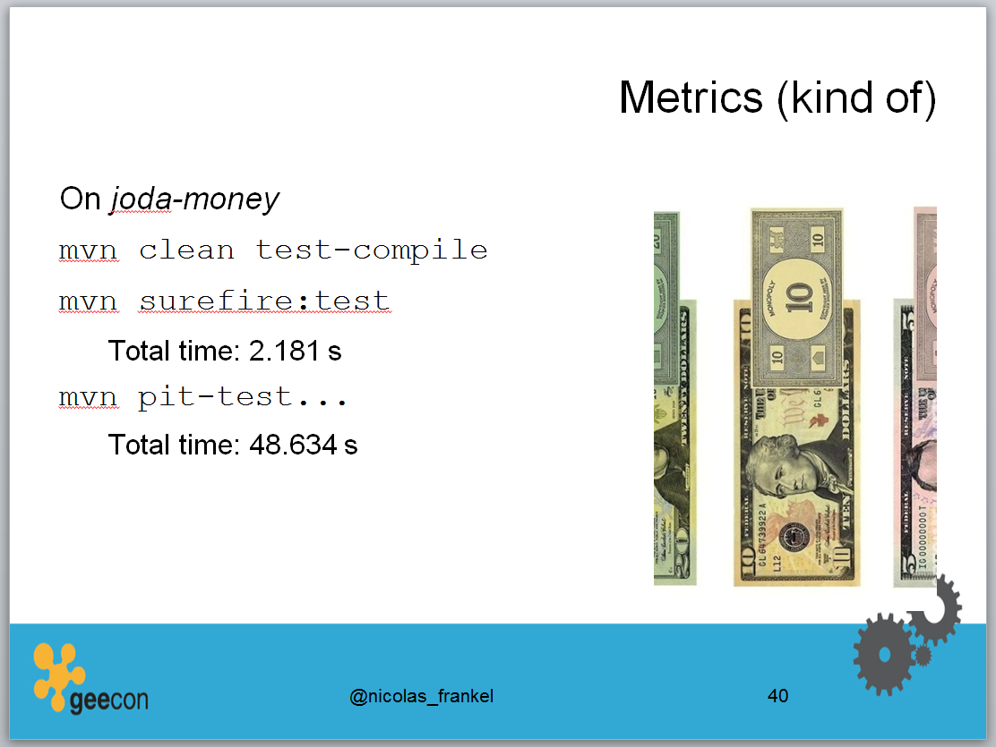
Time metrics…

Slide 29
Configure !
<configuration>
<mutators>
<mutator>
CONSTRUCTOR_CALLS
</mutator>
<mutator>
NON_VOID_METHOD_CALLS
</mutator>
</mutators>
</configuration>

Slide 30
Configure – setting target classes
<configuration>
<targetClasses>
<param>pl.com.tt.mutants*</param>
</targetClasses>
</configuration>

Slide 31
Configure – limit dependency distance
<configuration>
<maxDependencyDistance>
4
</maxDependencyDistance>
</configuration>
Mutant 1
Mutant 2
1
2
Test
Dependency

Slide 32
Configure – limit number of mutations
<configuration>
<maxMutationsPerClass>
10
</maxMutationsPerClass>
</configuration>

Slide 33
Configure !
Don’t be tempted to use mutation testing on test phase (for ex. Unit test etc.)
<plugin>
<groupId>org.pitest</groupId>
<artifactId>pitest-maven</artifactId>
<executions>
<execution>
<goals>
<goal>mutationCoverage</goal>
</goals>
<phase>test</phase>
</execution>
</executions>
</plugin>

Slide 34
Configure !
scmMutationCoverage goal
The scm mutation coverage goal analyses only classes that match the filters and the source file has a given status within the project source control system (by default ADDED or MODIFIED). This provides a quick way to check the coverage of changes prior to checking code in / pushing code to a repository.

Slide 35

Tips and tricks
How to help Yourself ?
Write fast unit tests
Good separation or concerns
Separate unit and integration tests
Use small classes

Slide 36

Summary
Pretty interesting technique – the best is yet to come
Not a silver bullet for code development !
Use on green field projects when aiming at high quality of a tests
…or when You have high CC and still poor quality of tests
Keep code quality when developing tests !
Be aware of limitations and corner cases
Don’t focus on 100% CC !
Stay open-minded ☺

Slide 37

Questions ?

Slide 38

That’s all Folks !

